Slide 1

Lucía Gutiérrez Molina
Inbal Hasson Tapiero
Alfonso Martínez Conejo
Javier Jordán Luque
Javier Zafra del Moral
Guillermo Pérez-Peña Martín
Lucía Corpas López
Jorge Velázquez Jiménez

Slide 2
Contents
Introduction
What We Offer
Teamwork
Requirements
Class Diagram
Sequence Diagram
Arquitecture
Environment
Testing
Database
Design Principles
Website
Why “CookItUp!”?
Conclusion

Slide 3
Introduction
Problems we want to solve:
Low appreciation of people for the food period and the importance of a good meal.
Increased usage of precooked and fast food in society.
Urgent need for more internet sites that substitute these unhealthy habits.
Solution: Creating a web for sharing recipes with people all over the world.

Slide 4
What We Offer
Interact with other people
Be innovative
Express yourself
Test and experiment with new creations

Slide 5
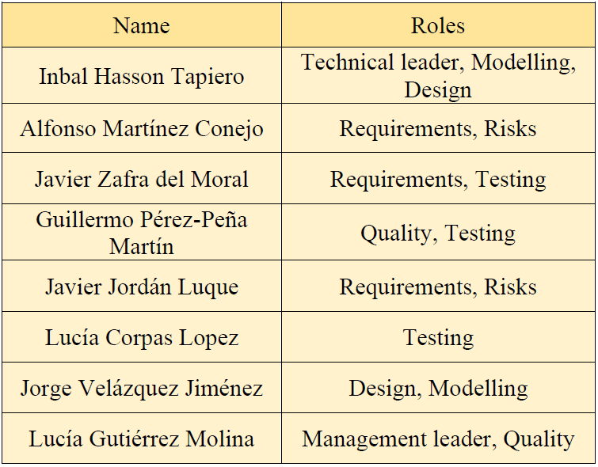
Planning
Roles Division

Slide 6
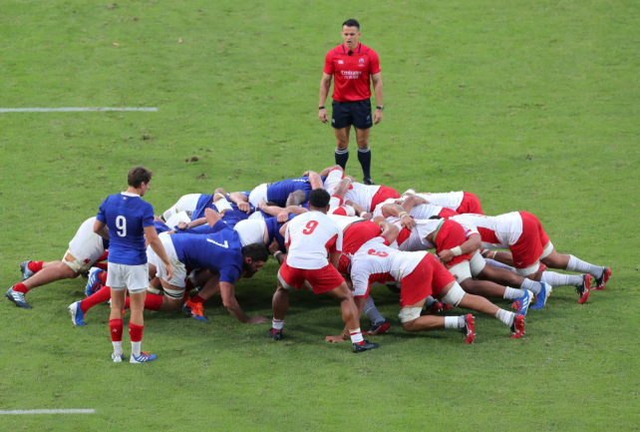
Planning
Agile Method: Scrum

Slide 7

Teamwork
Monday and Friday Meetings
Extra Online Meetings via Discord
Individual Reports per 2 Weeks

Slide 8
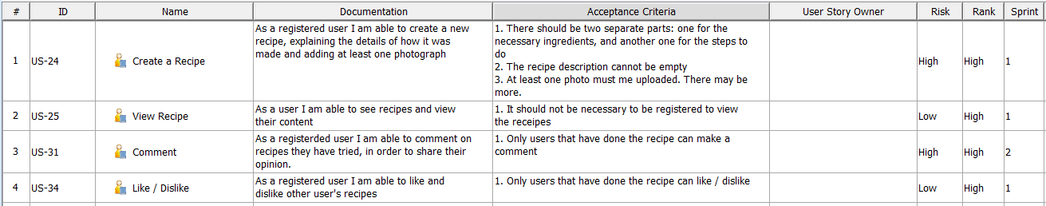
Requirements
User Stories
Some Examples:

Slide 9
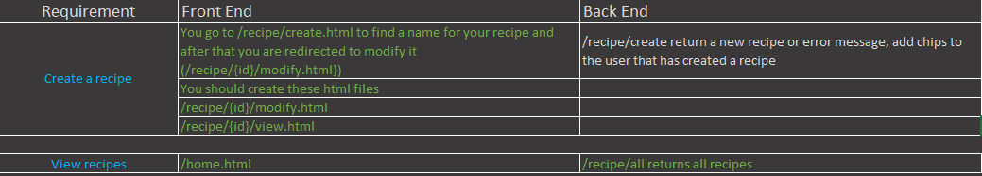
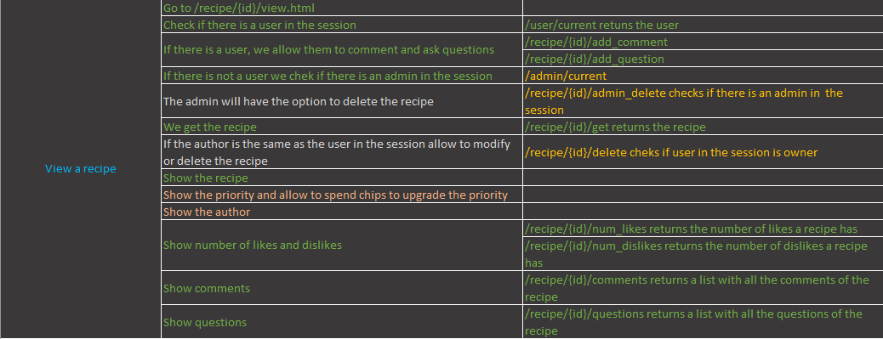
Requirements

Slide 10
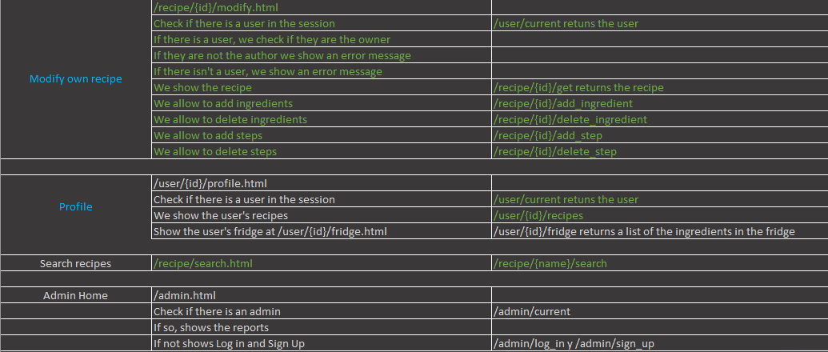
Requirements

Slide 11
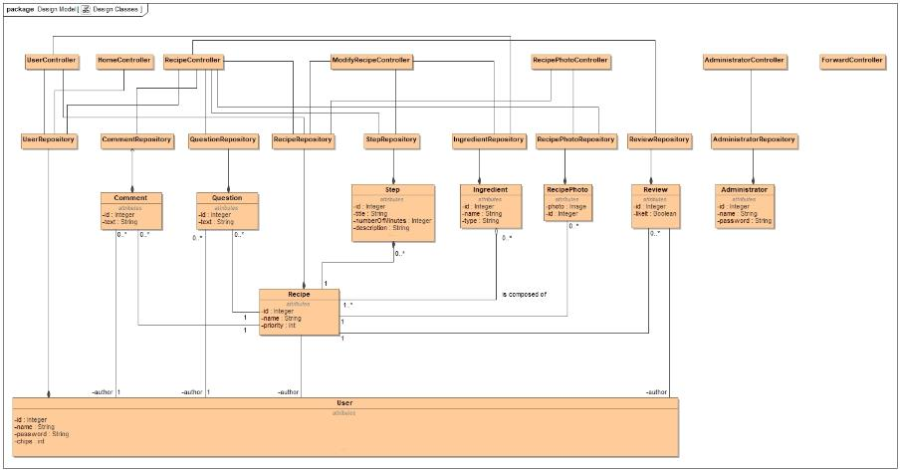
Class Diagram

Slide 12
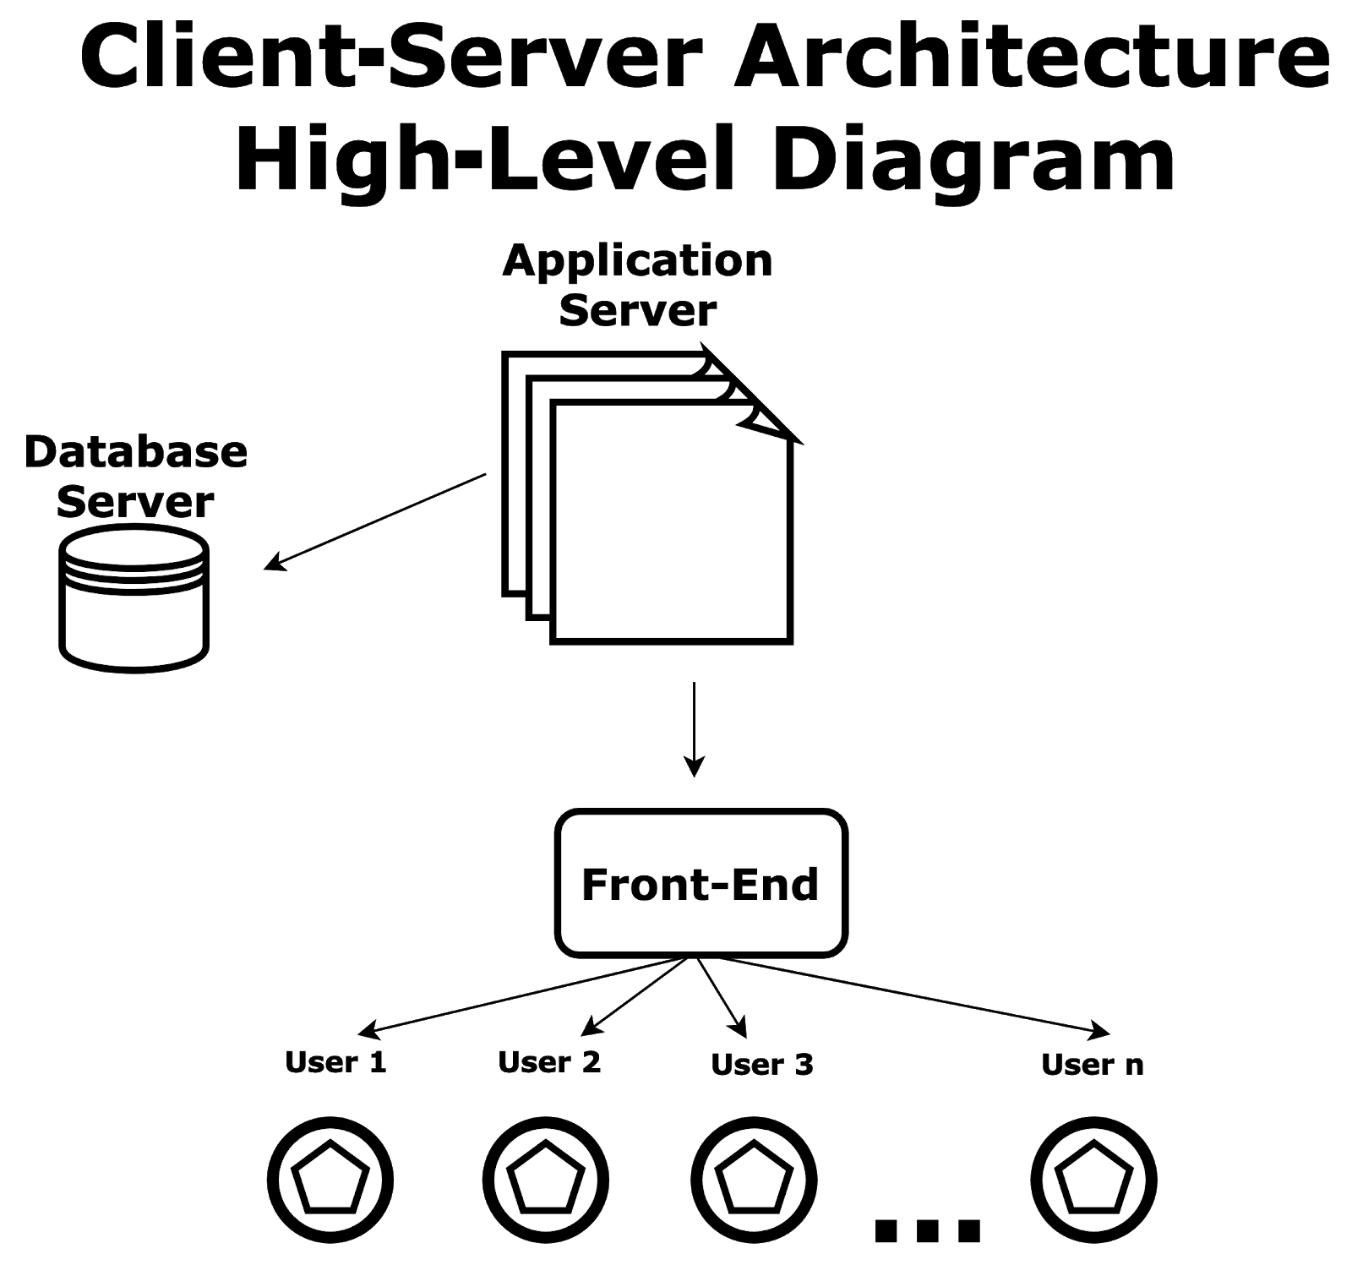
Architecture

Slide 13


Environment
Java
JavaScript
IntelliJ IDEA
HTML

Slide 14

Testing
Mockito Extension
Java language
Functional tests

Slide 15
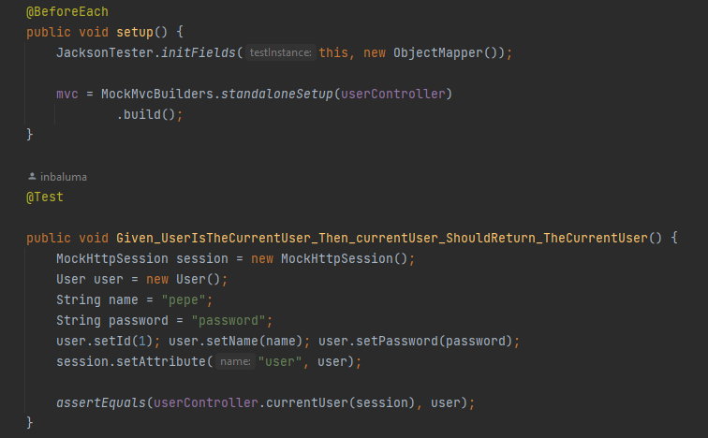
Testing
Example test: User Controller

Slide 16
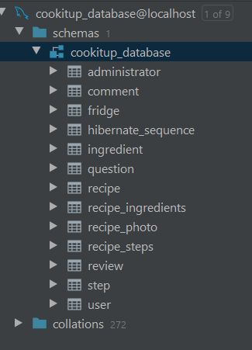
Database
Text Files

Slide 17
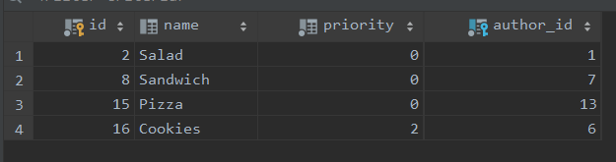
Database
Recipe example

Slide 18
Design Principles
Modularity
Increase Cohesion
Reduce Coupling
Singularity
Interface Segregation

Slide 19

Website
Home page:

Slide 20
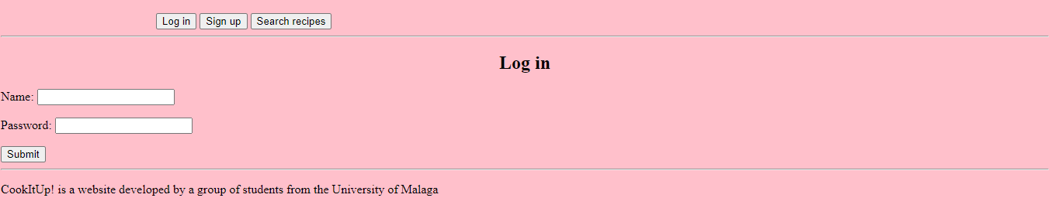
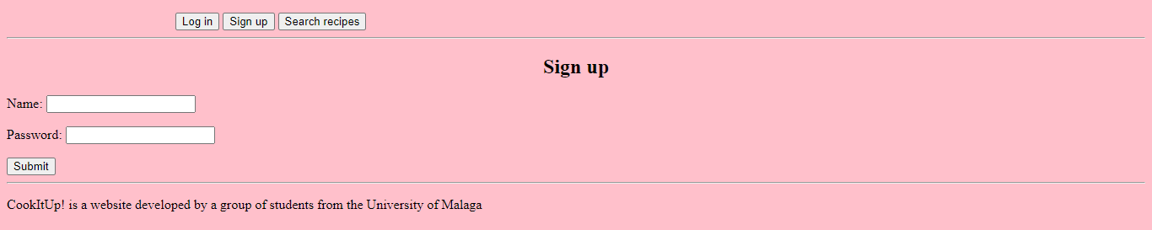
Website

Slide 21
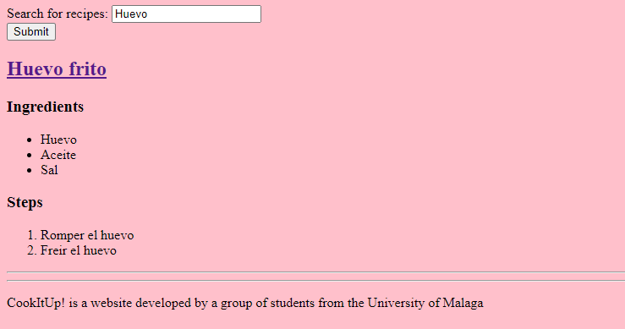
Website
Search recipes:

Slide 22
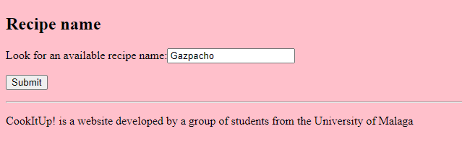
Website
Create a recipe:

Slide 23
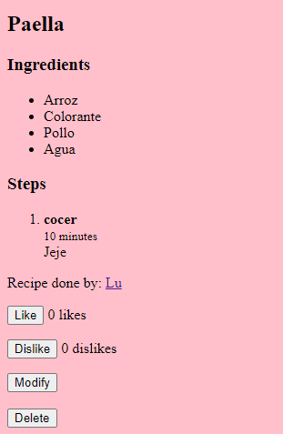
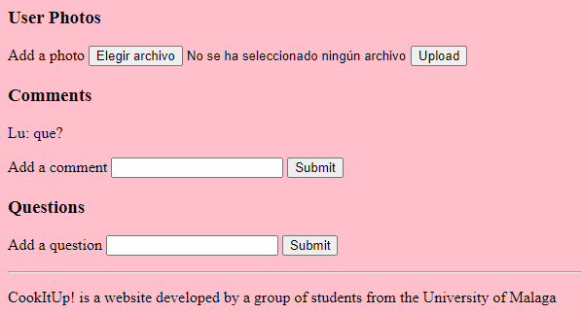
Website
View a recipe

Slide 24
Why “CookItUp!”?
Young
Ambicious
Entertaining without addiction

Slide 25
Results and Conclusion
Results: Website
What we have learned…
Teamwork
Responsability
Importance of schedule

